Slide 1

DevOPS for SCALA
Version 2.0
Cloud Building
for Scala Enthusiasts
Michele Sciabarrà
michele@sciabarra.com

Slide 2

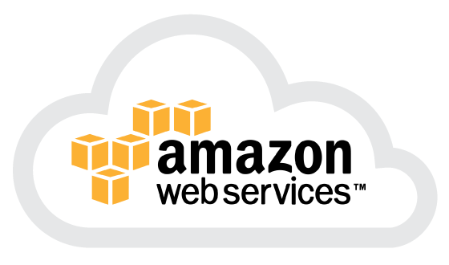
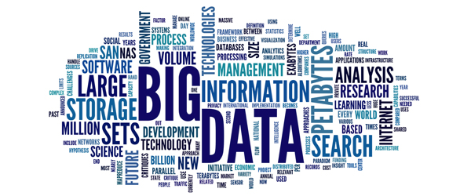
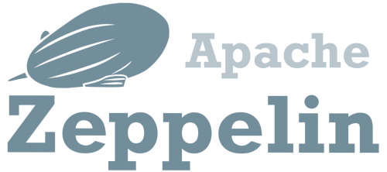

Let's do Big Data in the Cloud

Slide 3



We could do things in the easy way...
Cloudera Distribution
DC/OS
Ambari

Slide 4


But we like simple things...
What they sell
What you need

Slide 5
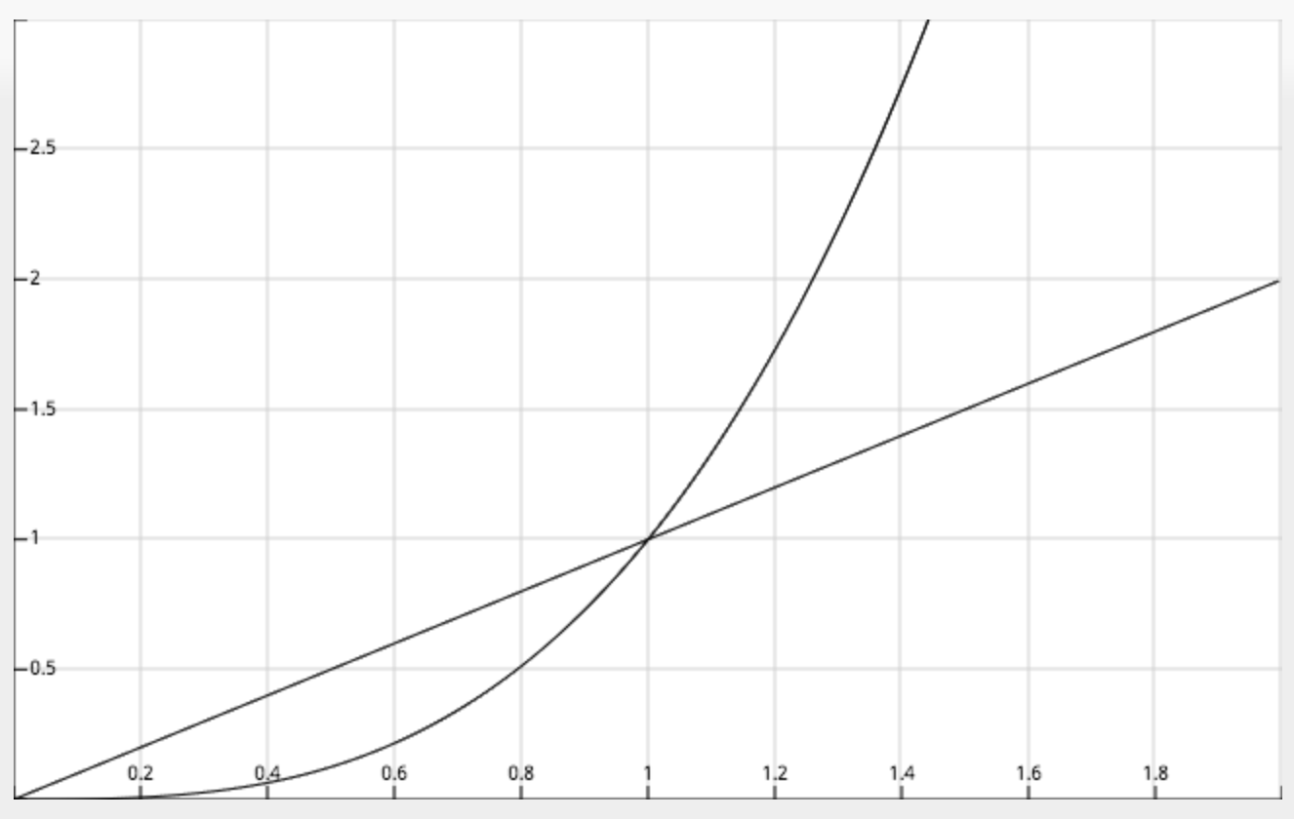
The problem with customisation
Effort
Third Part
Home Grown
Amount of Customisation

Slide 6
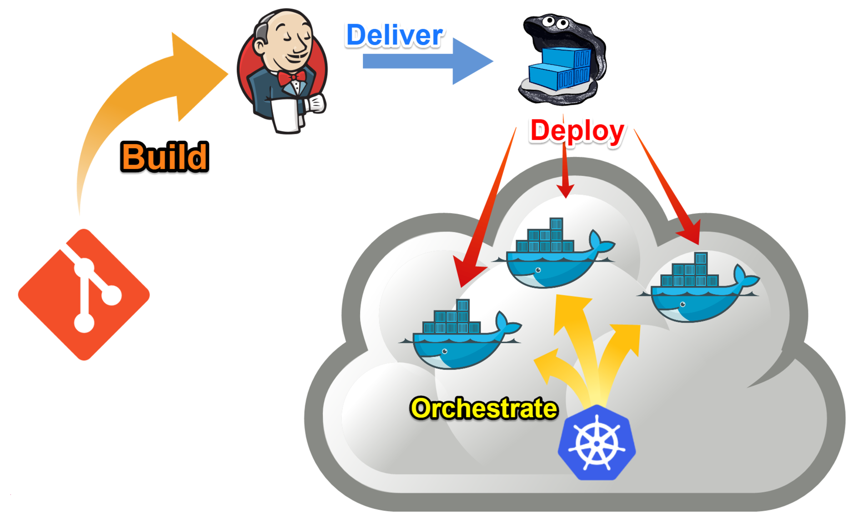

Mission Statement

Slide 7
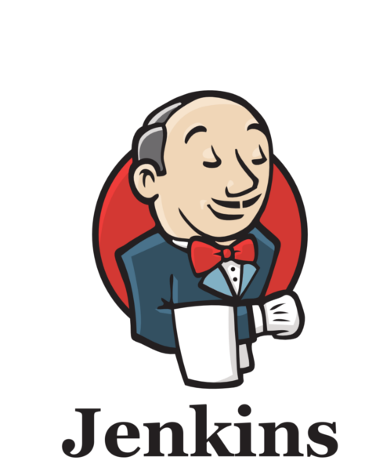
What I want
What I want:
Everything in AWS
Everything in Docker
Everything built with Jenkins
And, of course:
Easy customizability
Easy orchestration
Cheapest solution in the cloud

Slide 8


What I do NOT want
What I DO NOT want:
Hadoop
(even if I like it)
Unused components eating precious memory in the cloud
Be stuck to one version of a component

Slide 9
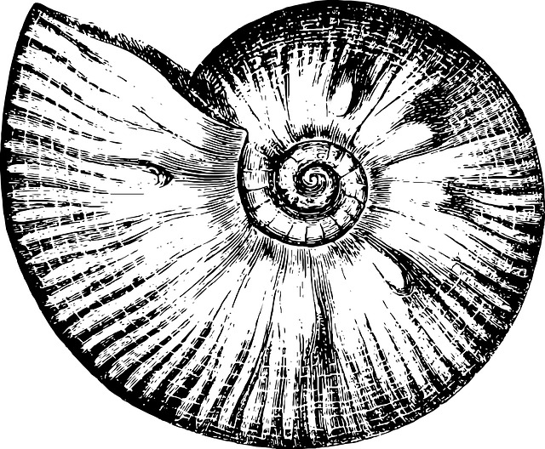
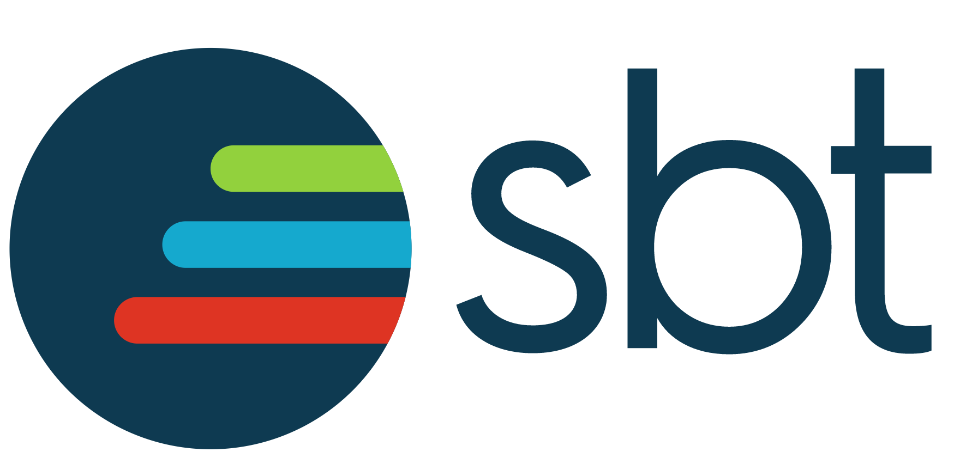
Introducing Mosaico 2
http://github.com
/sciabarracom/Mosaico2
It is not a distribution!
It is not a framework!
Open Source
It is a "starter kit" for
creating a cloud in AWS with Terraform
Installing Docker and Docker Swarm with Ansible
Building Images with Jenkins and SBT
Orchestrating services with Docker Compose
Ammonite
Warning: documentation is sparse!

Slide 10
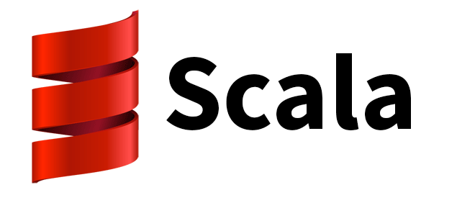
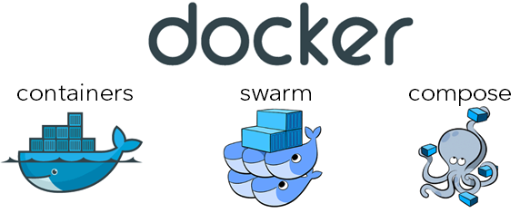
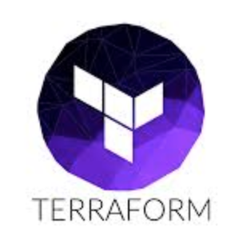
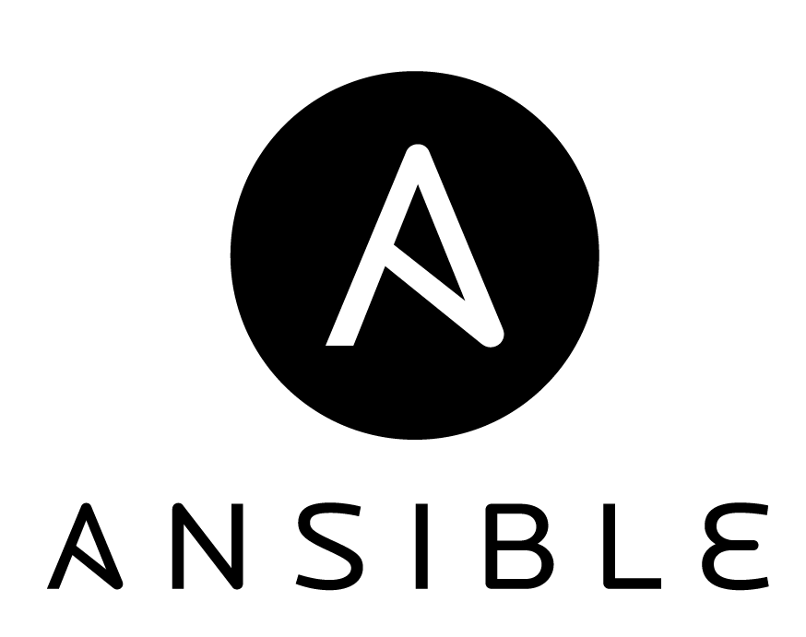
Building on the shoulders of giants
Ammonite

Slide 11
Yes, but what is in it, really?
Build Kit for Docker Swarm + Jenkins
Terraform + Ansible in AWS
A Deployment for Spark+Zeppelin
Master, Slaves, Notebook
A collection of BigData Docker Images
buildable with Jenkins and SBT
Scripts to start/stop/proxy the Cloud
A SBT Plugin to support Docker and Ammonite

Slide 12

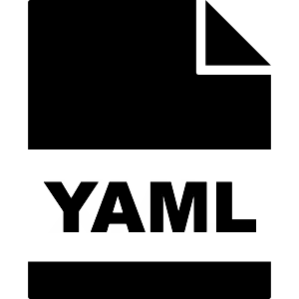

The real life of a DevOps
HCL

Slide 13
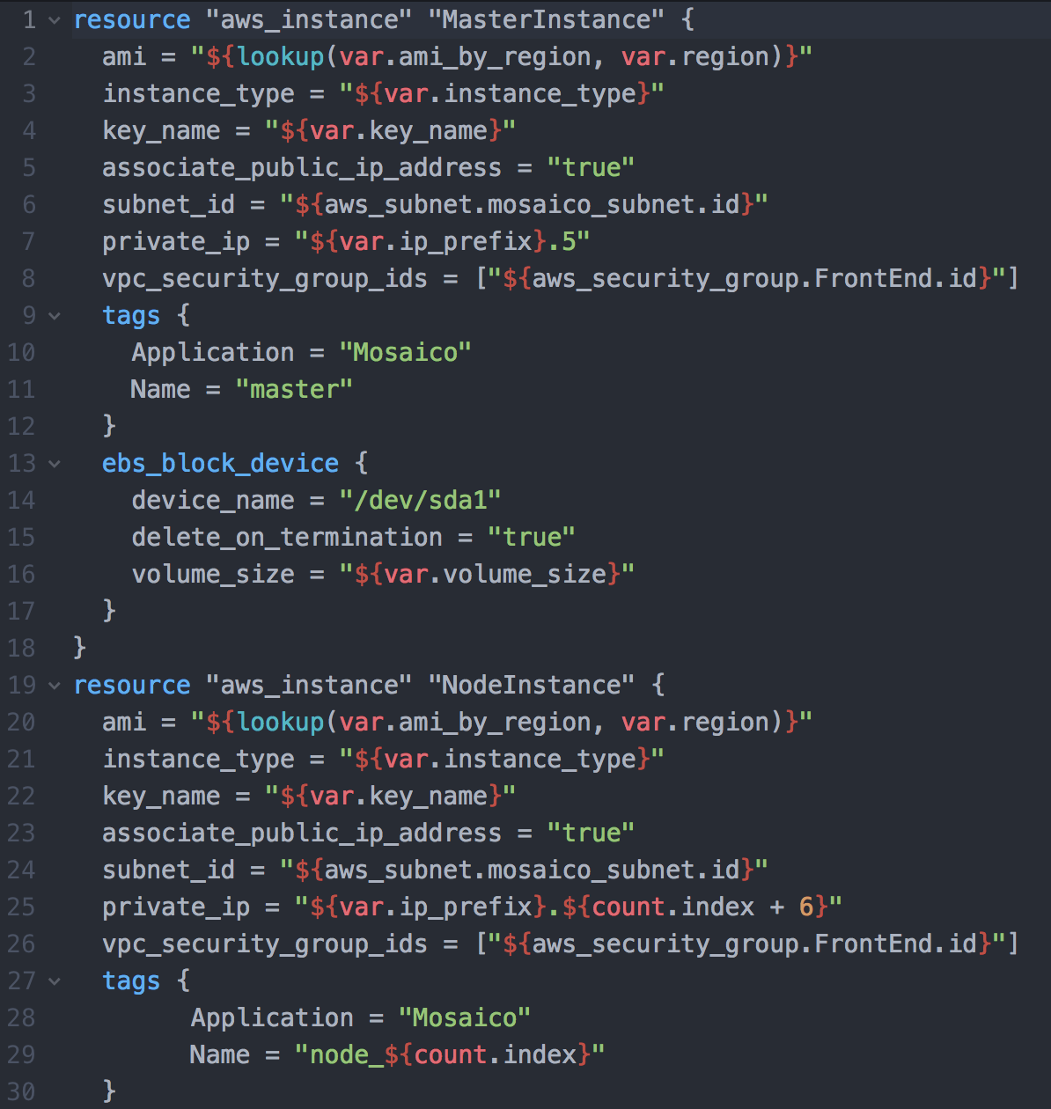
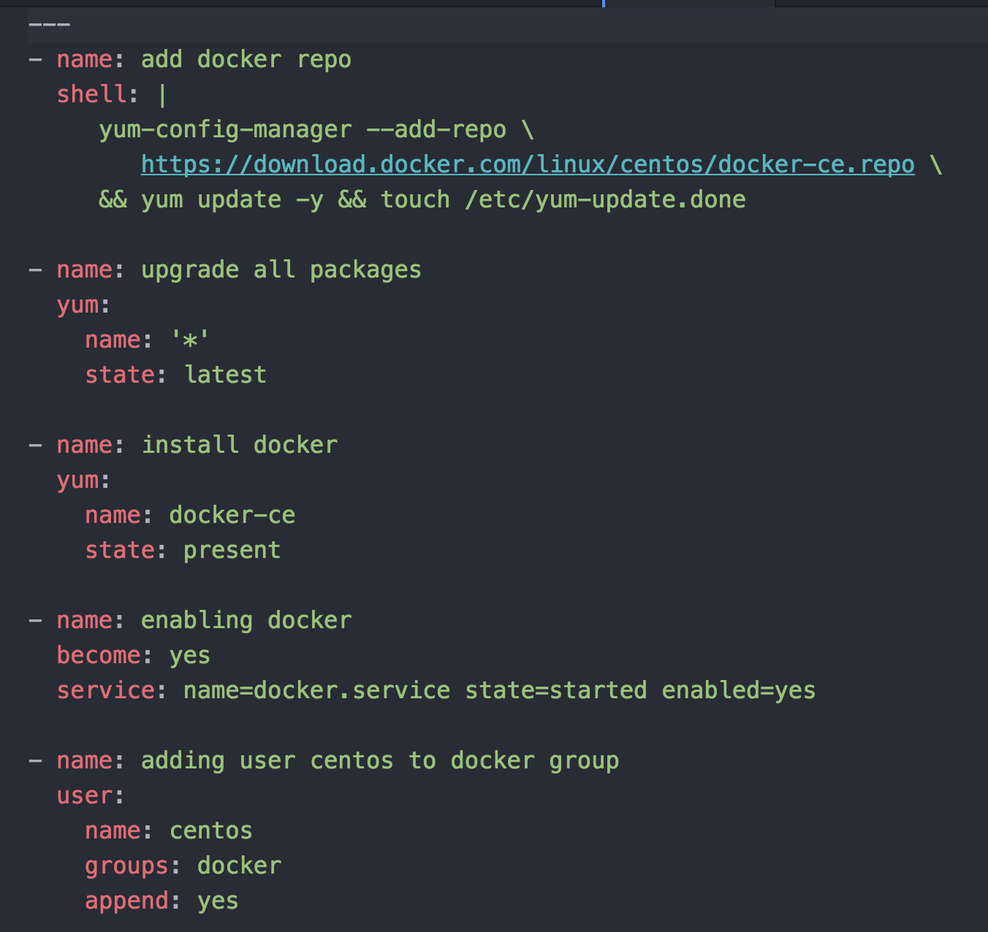
How ansible and terraform looks like
Terraform
Ansible

Slide 14


How I feel when I script with
BASH
SCALA

Slide 15



Bonus slide: Other feelings
PERL
PYTHON
RUBY

Slide 16
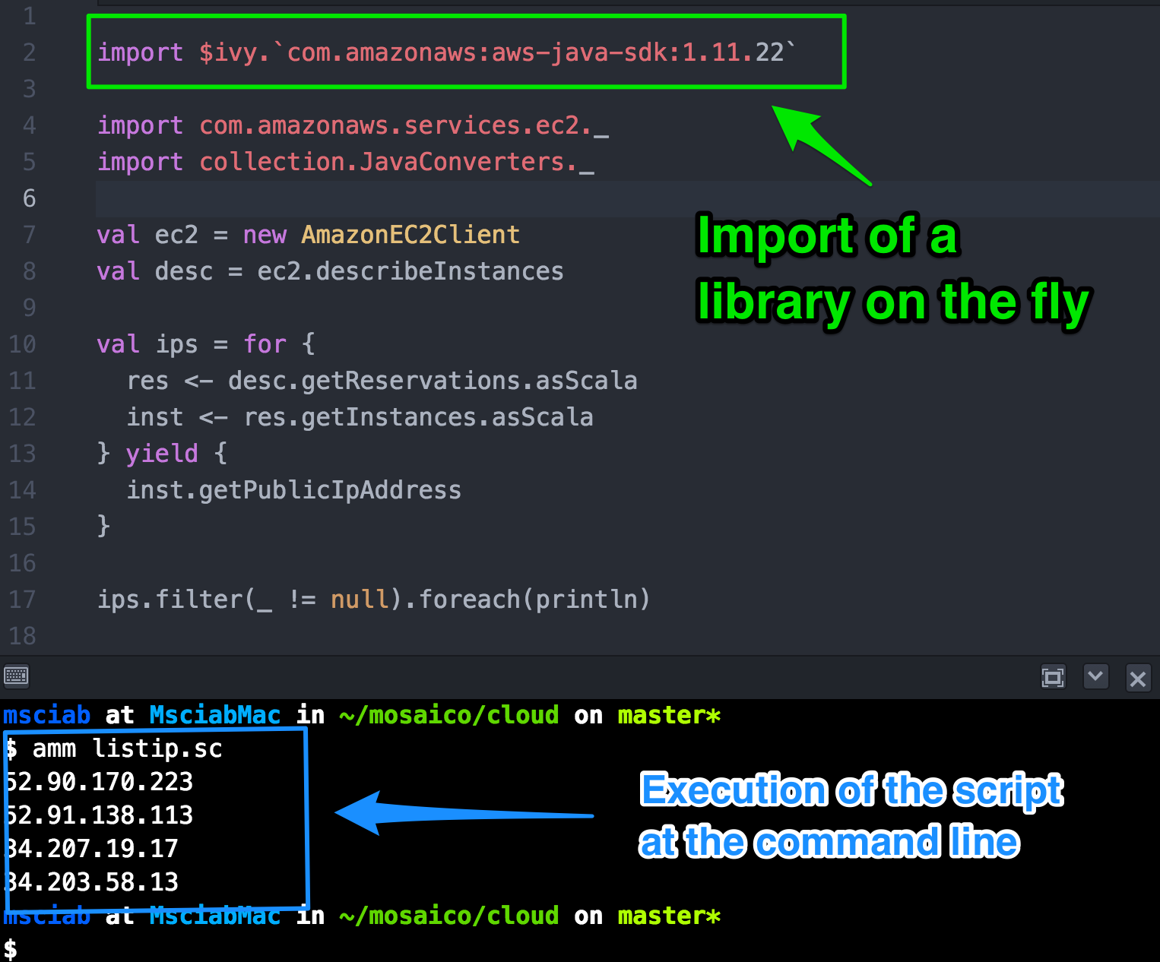

Introducing
Ammonite
by Li Haoyi
Used as
REPL in
Dotty
(Scala 3.0)

Slide 17
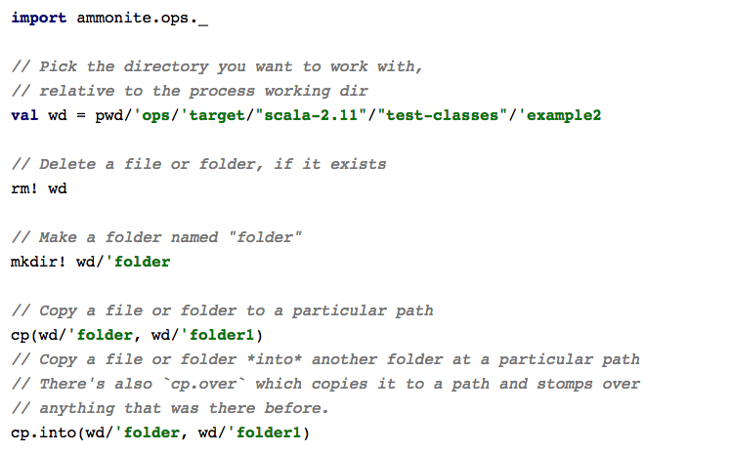
Ammonite Scripting features

Slide 18
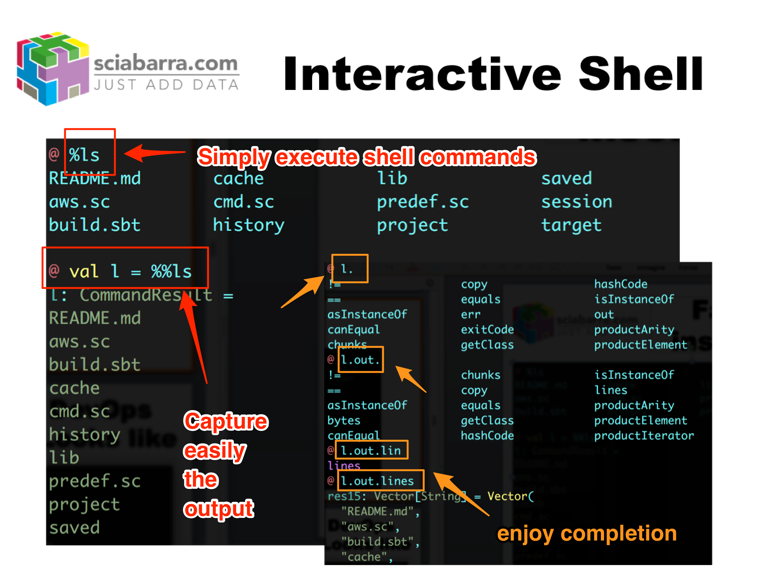
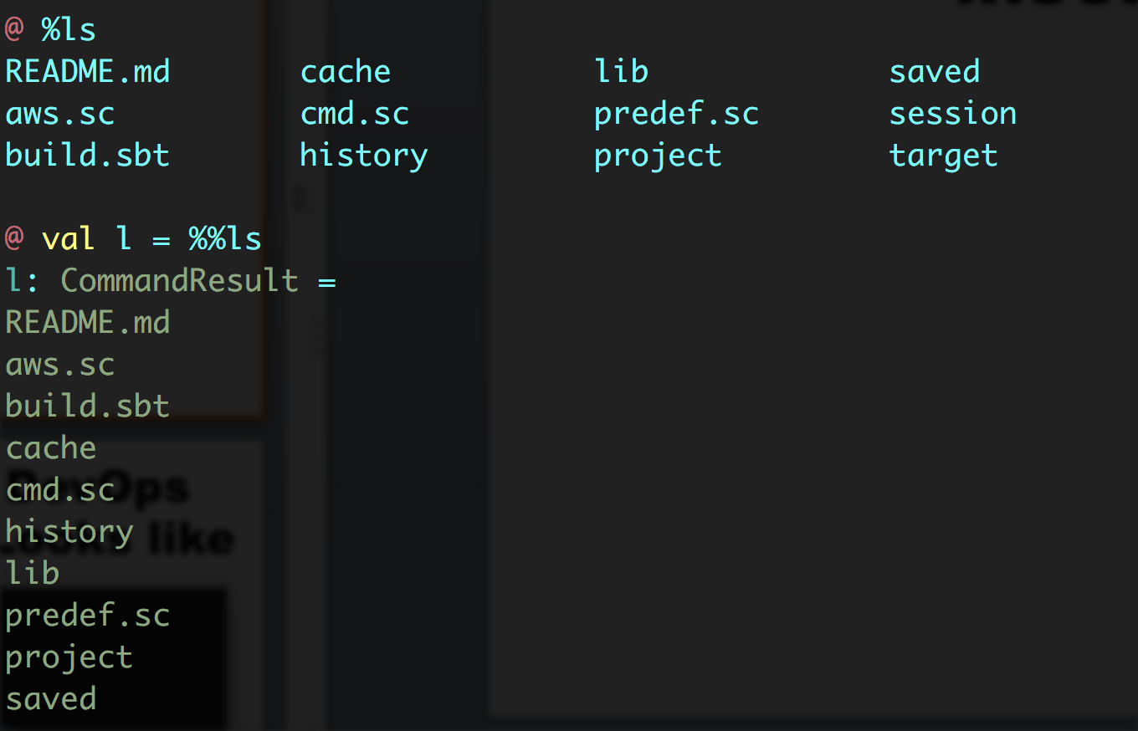
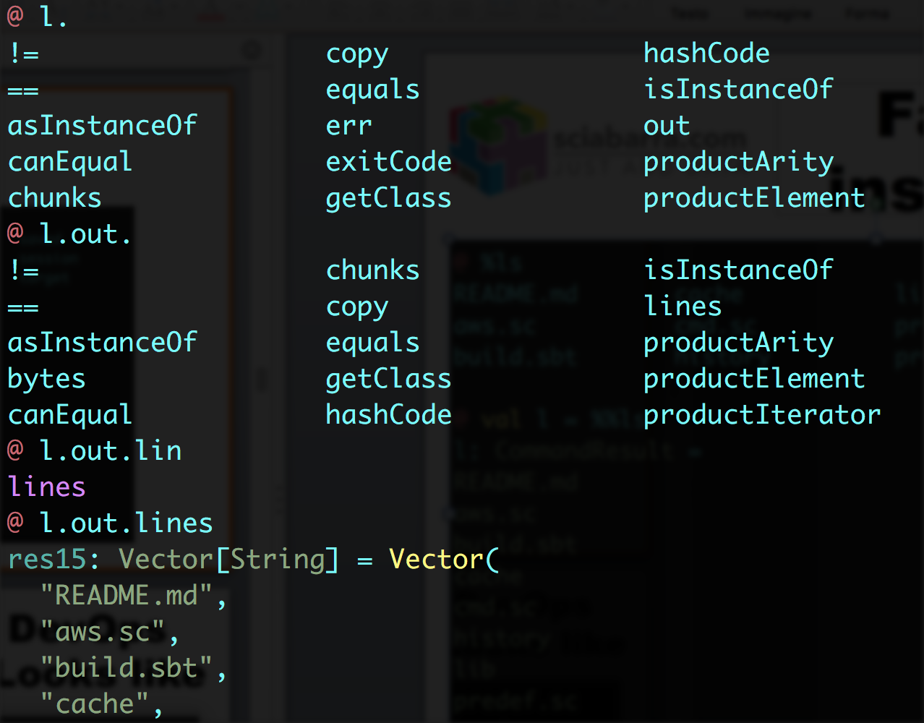
Interactive Shell

Slide 19
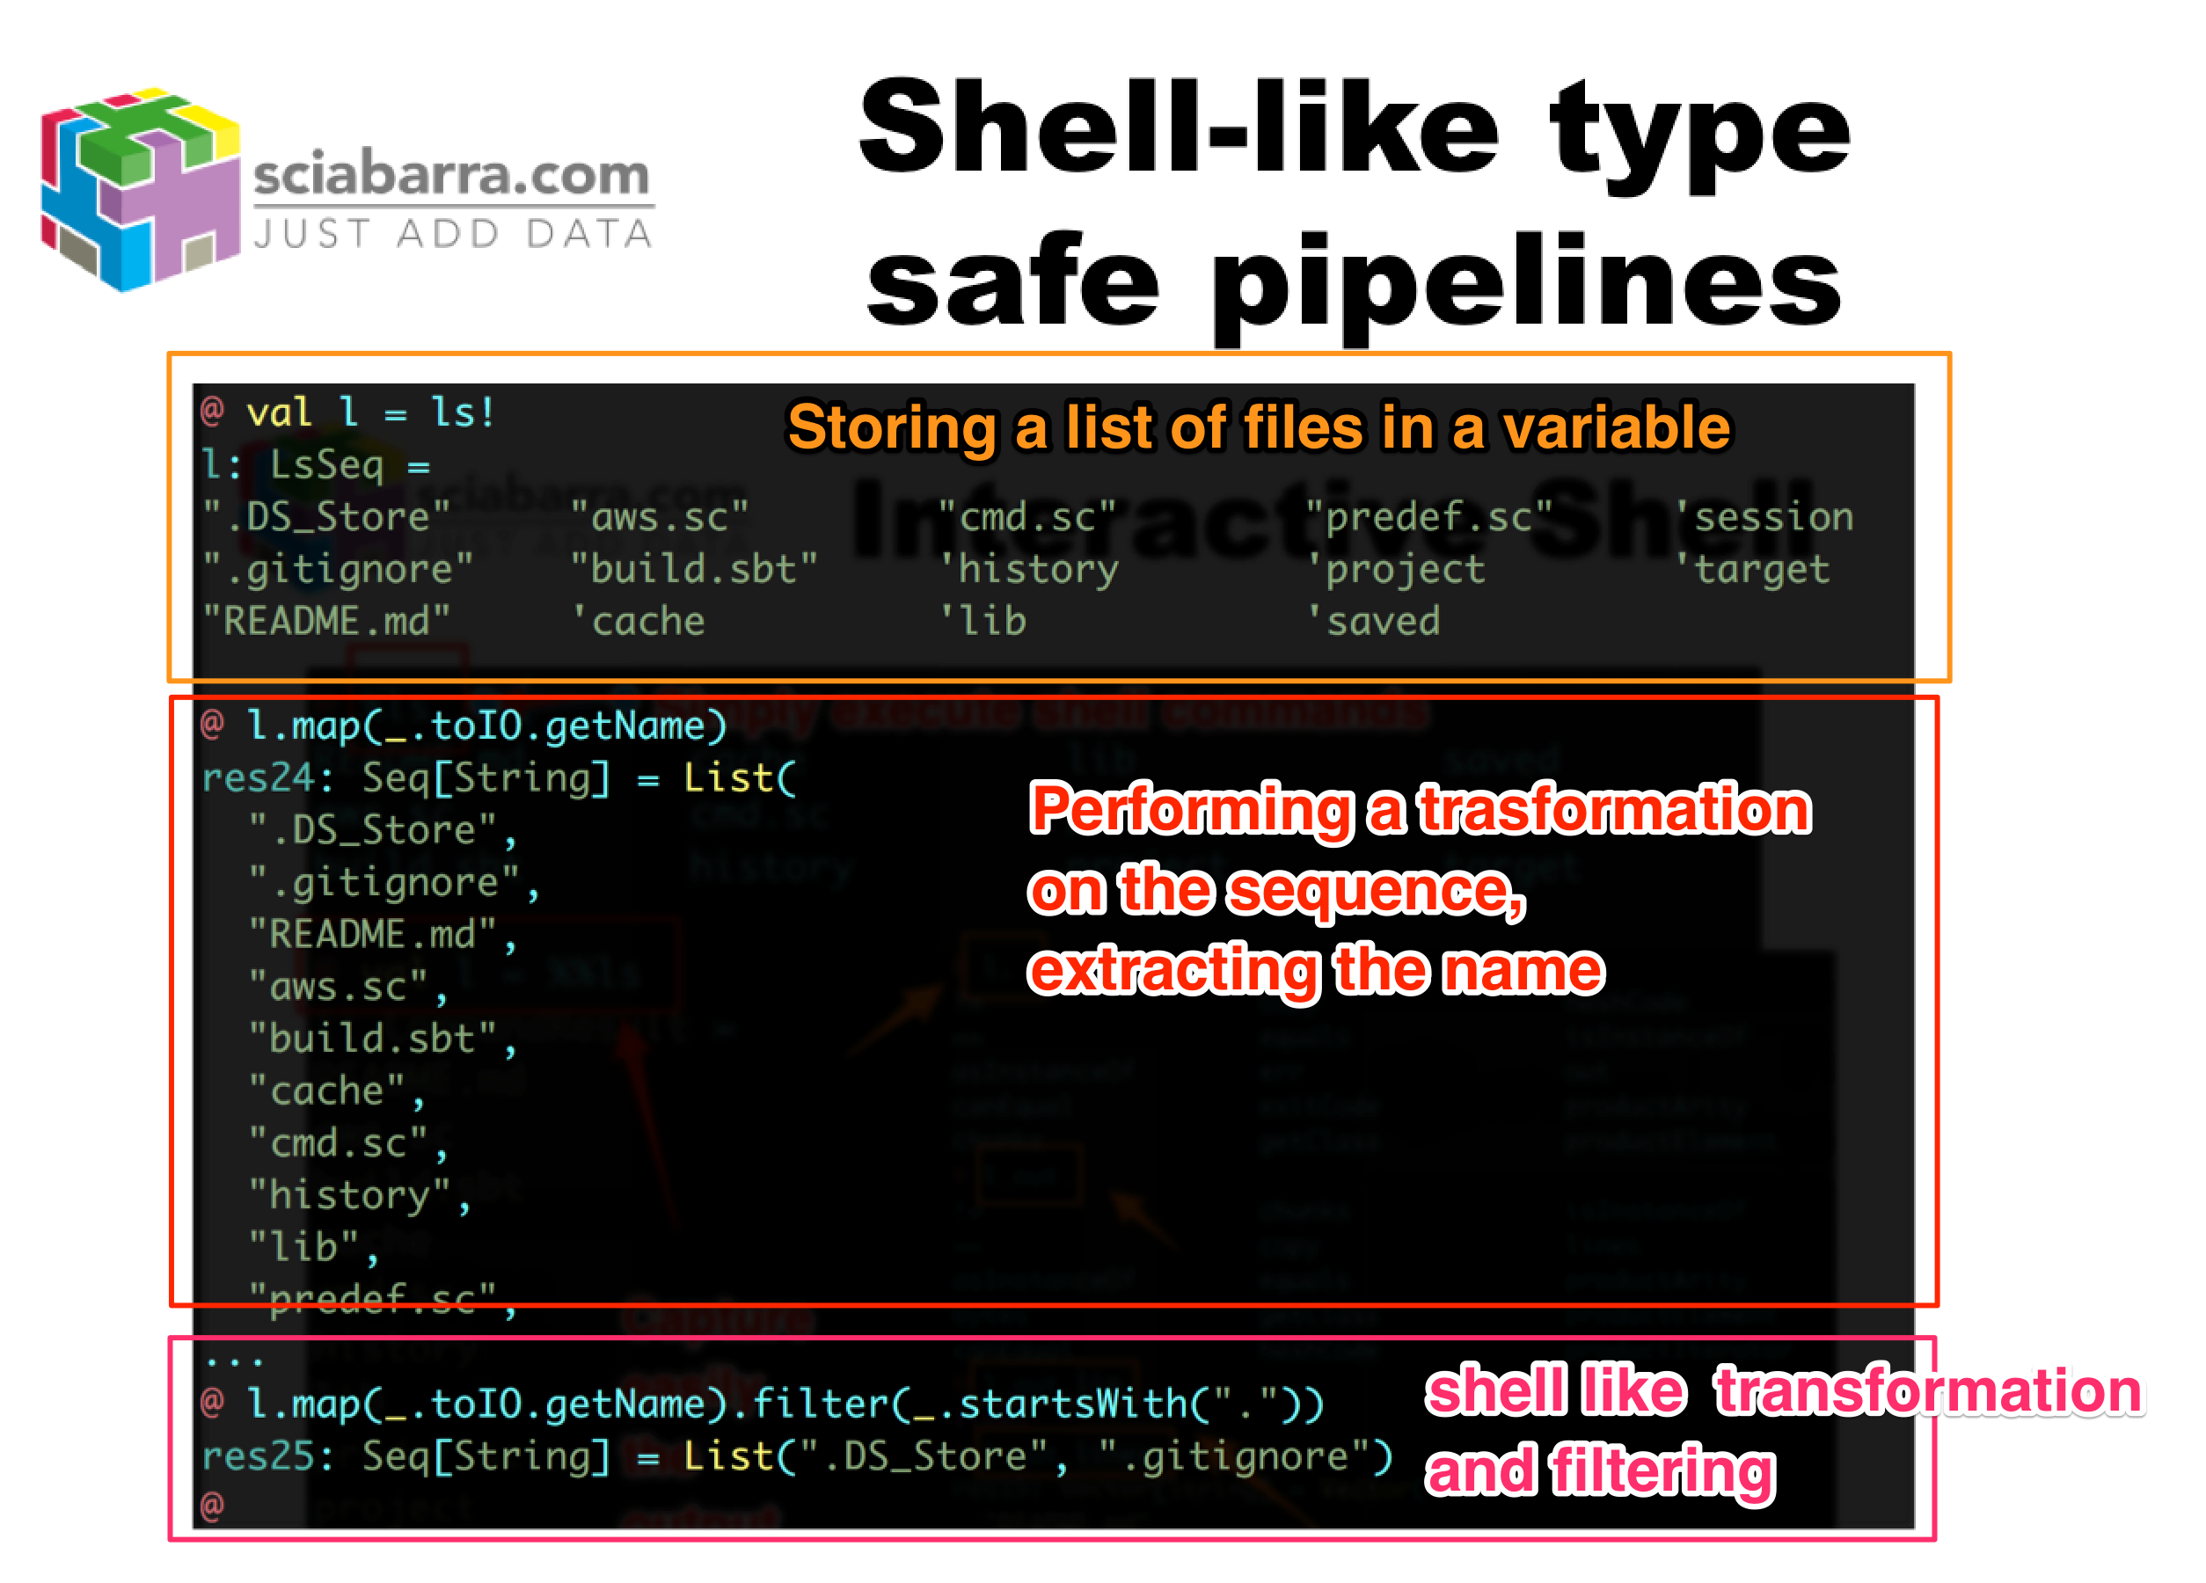
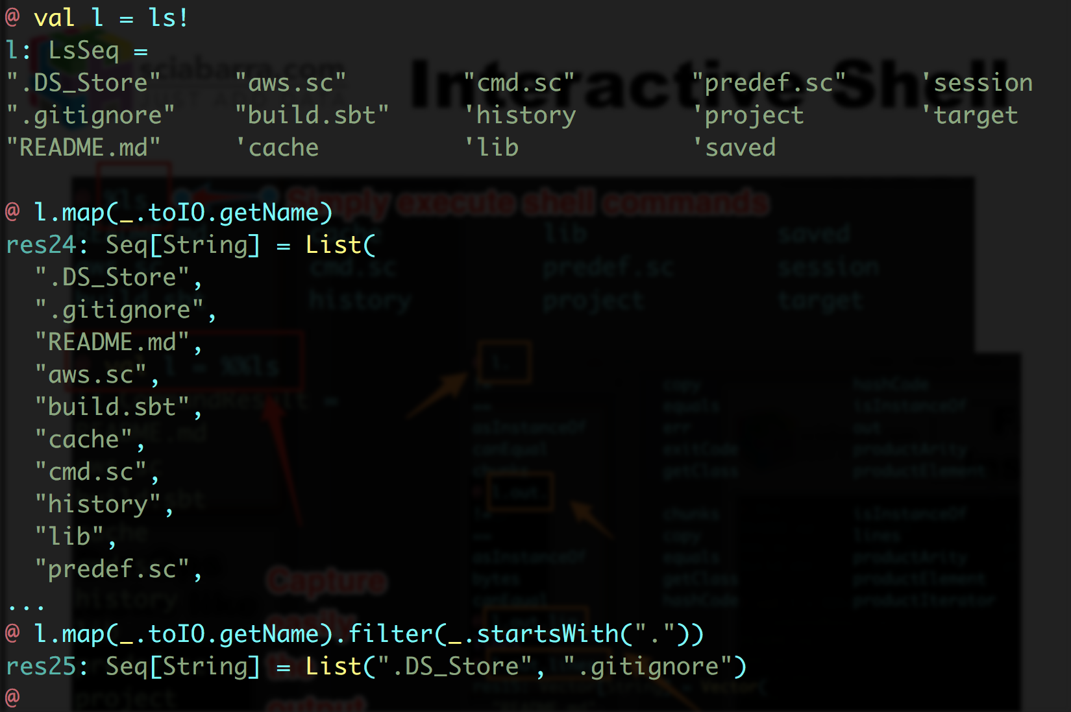
Shell-like type safe pipelines

Slide 20
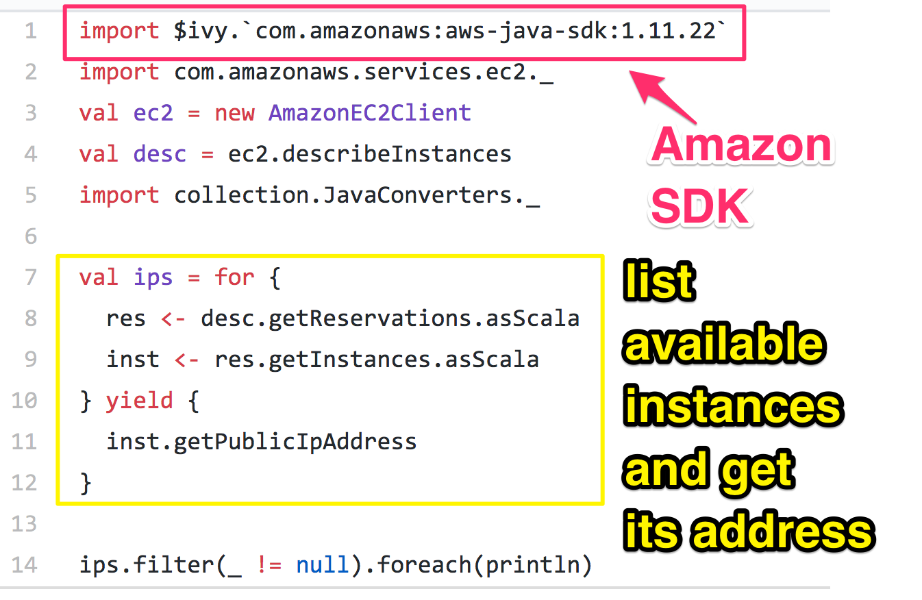
Easy Access to Cloud Libraries

Slide 21
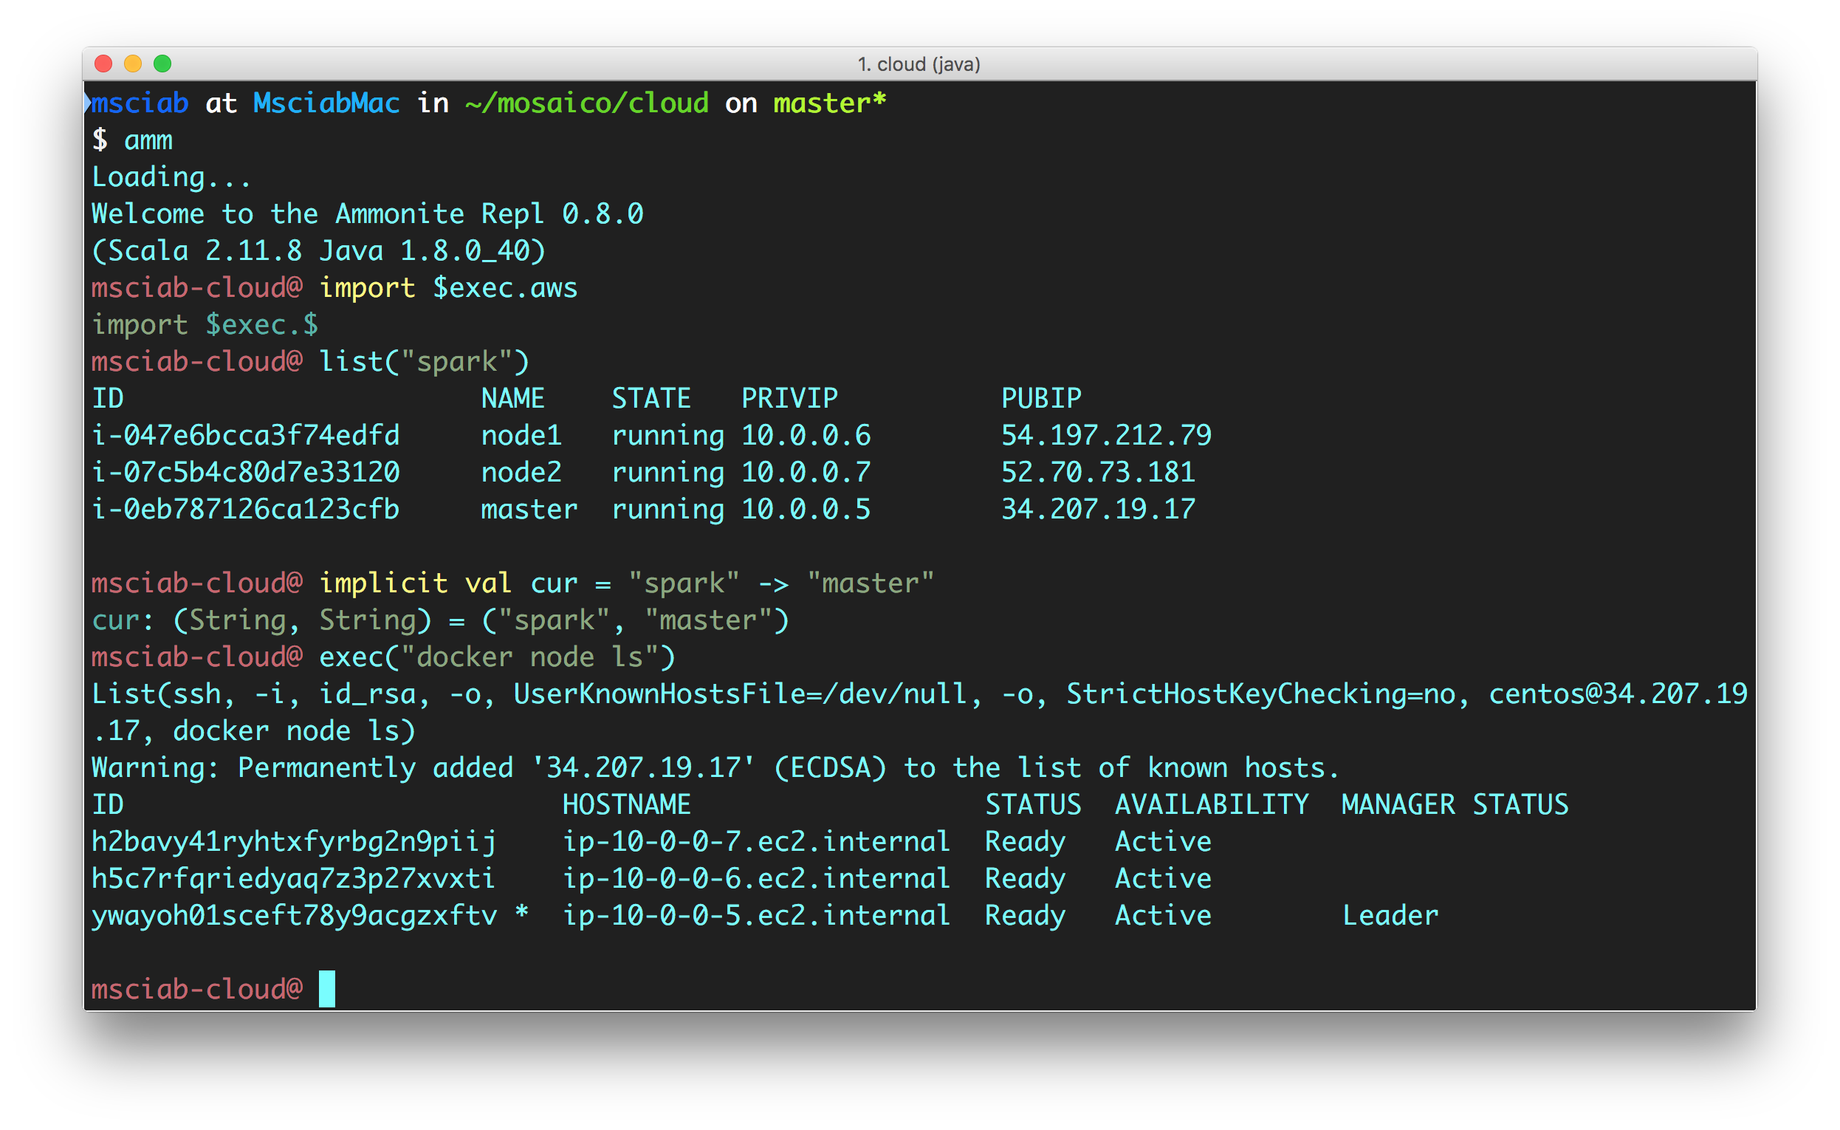
How a DevOps DevEnv Looks like

Slide 22
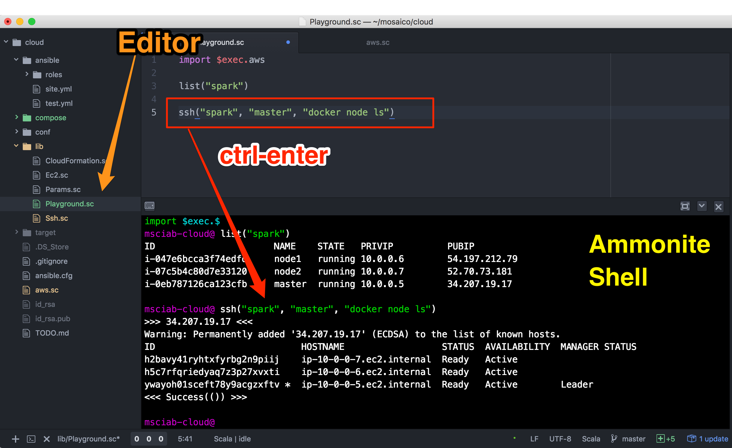
Developing with ease

Slide 23
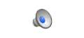
Ammonite within Atom

Slide 24
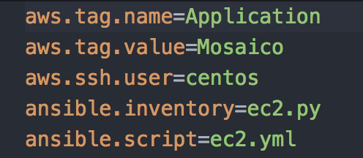
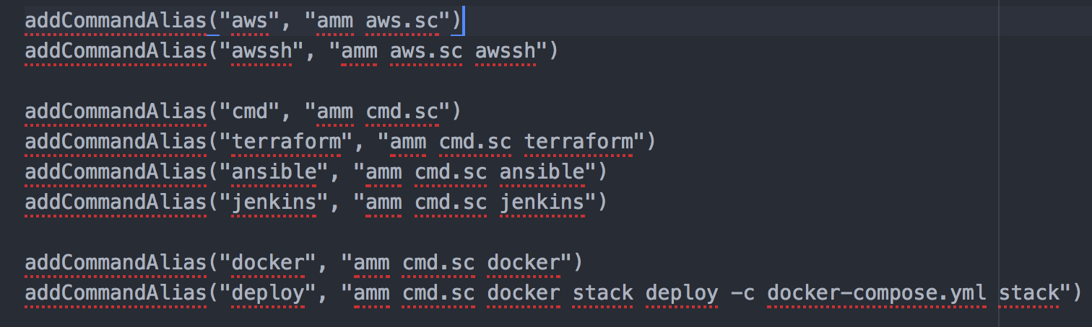
Ammonite & SBT
SBT provides
launch
command line
configuration
macros

Slide 25
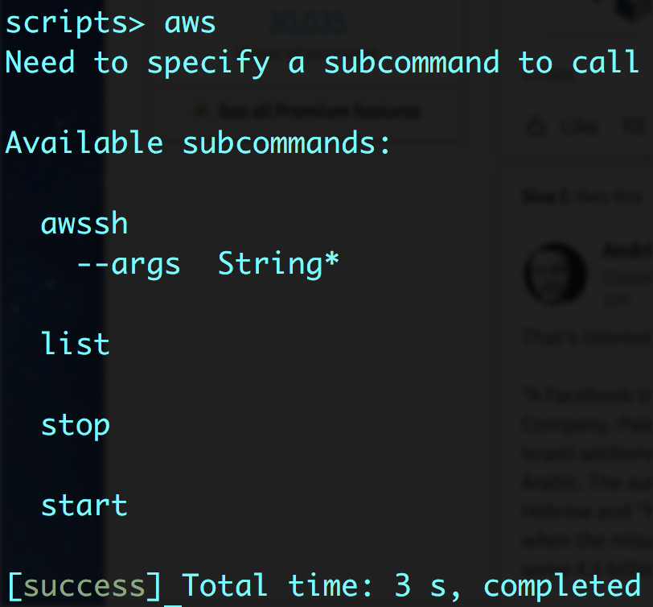
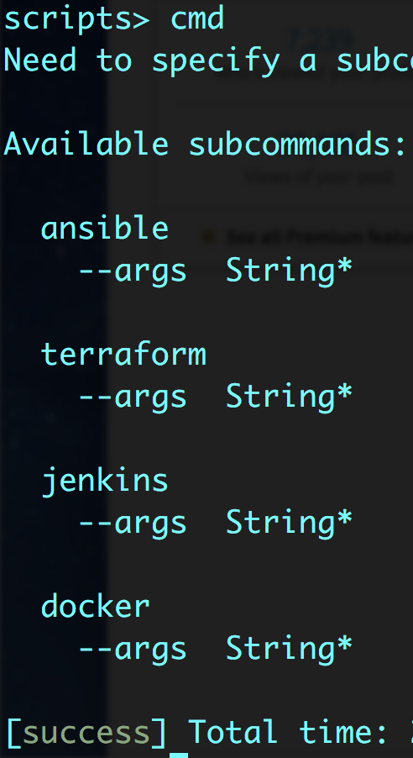
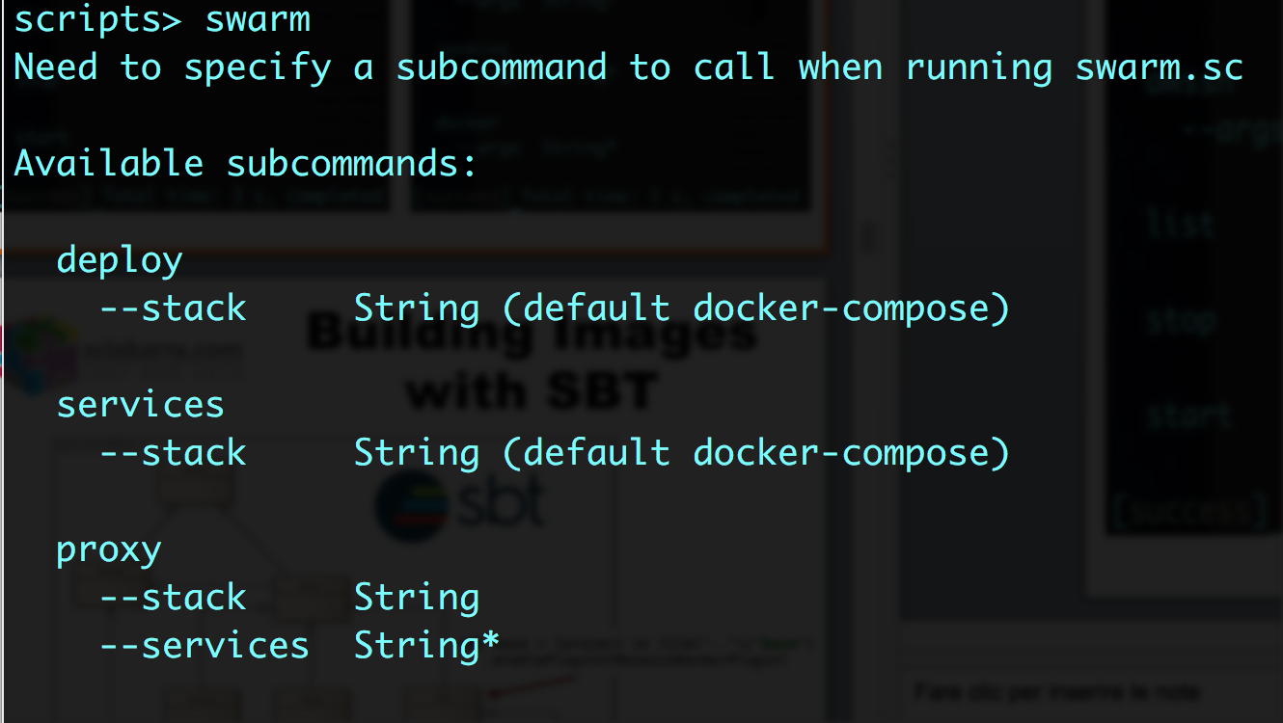
Three Ammonite scripts to rule it all

Slide 26
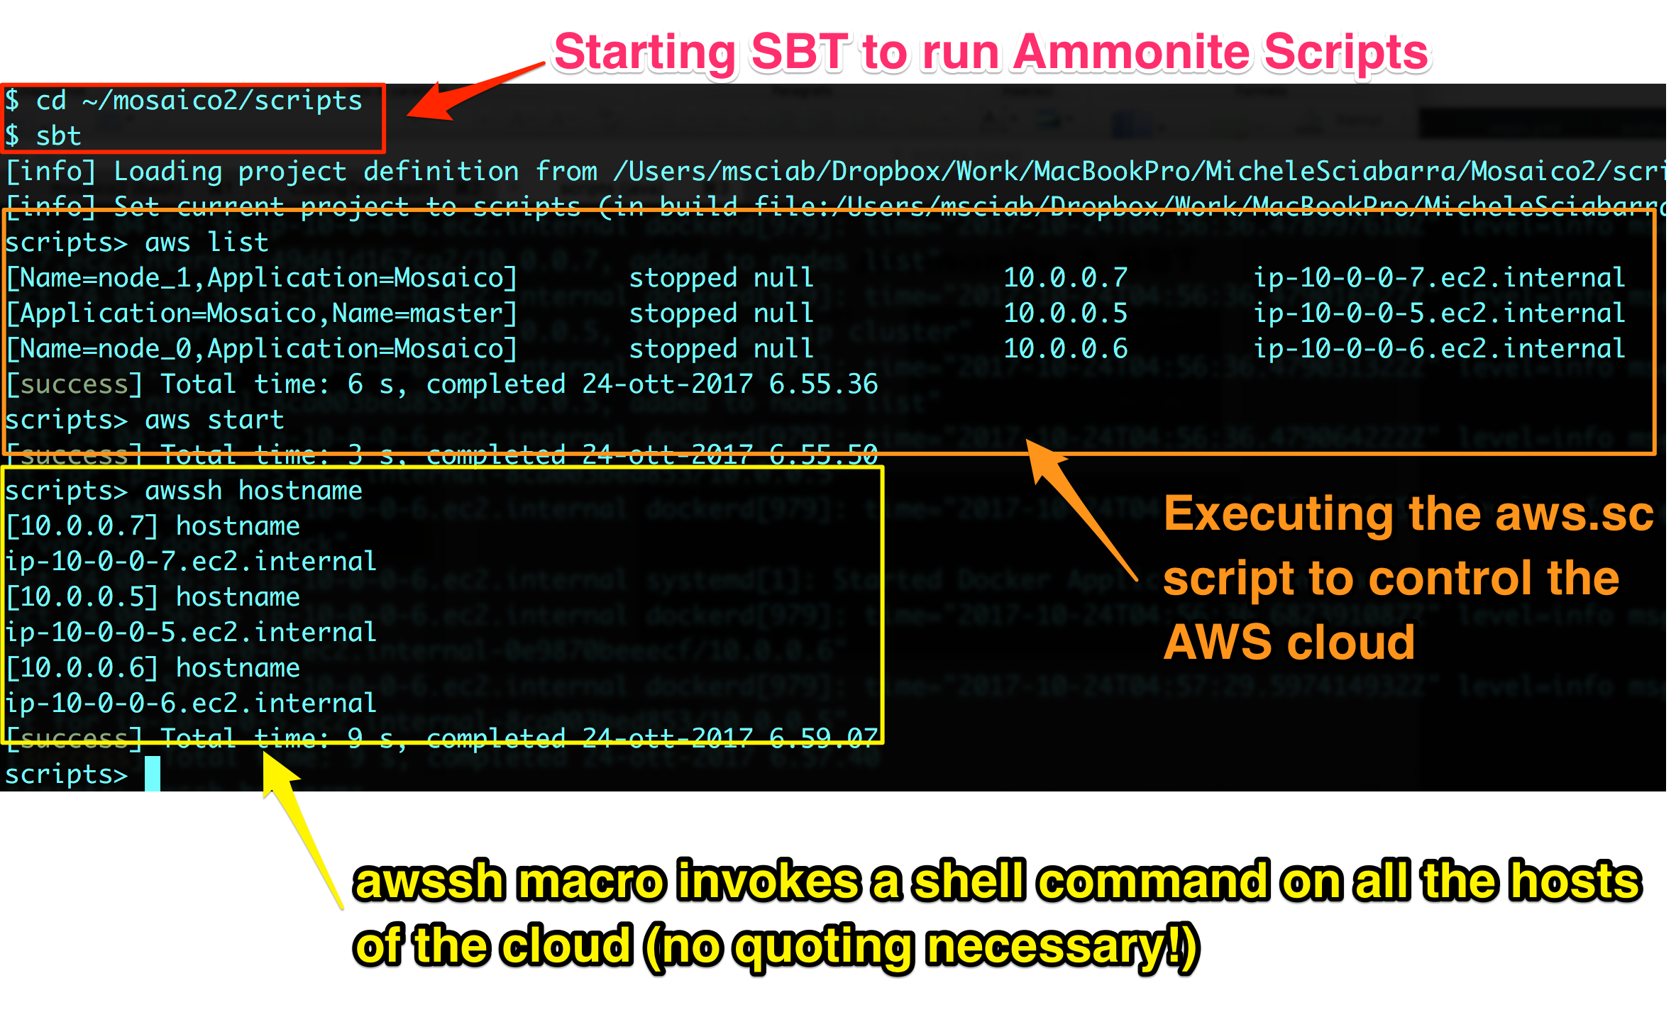
Ammonite-in-SBT in action

Slide 27
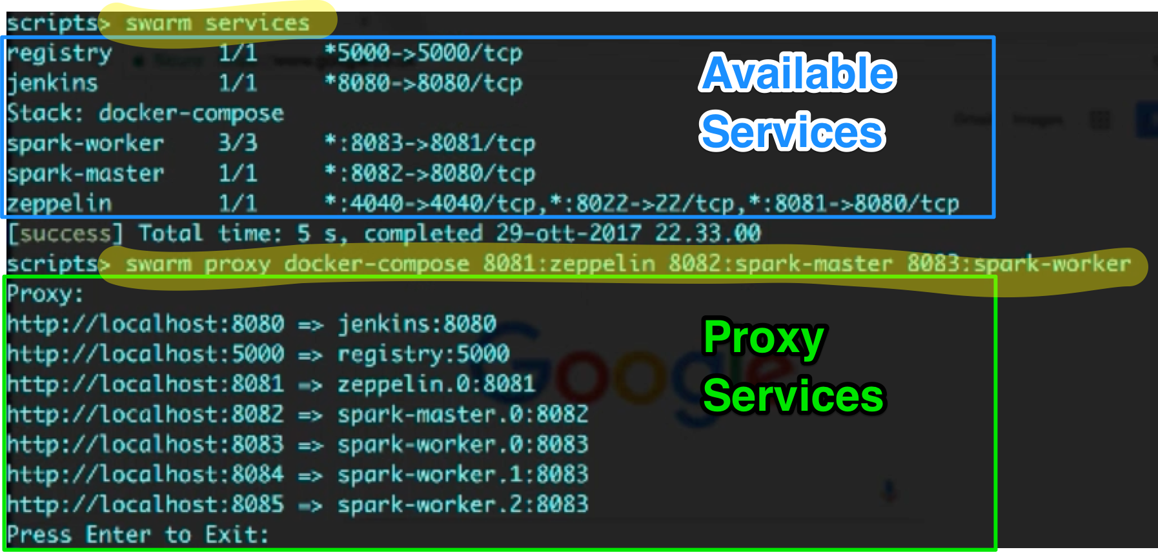
Security, security...
Proxying ports to access to internal services.

Slide 28
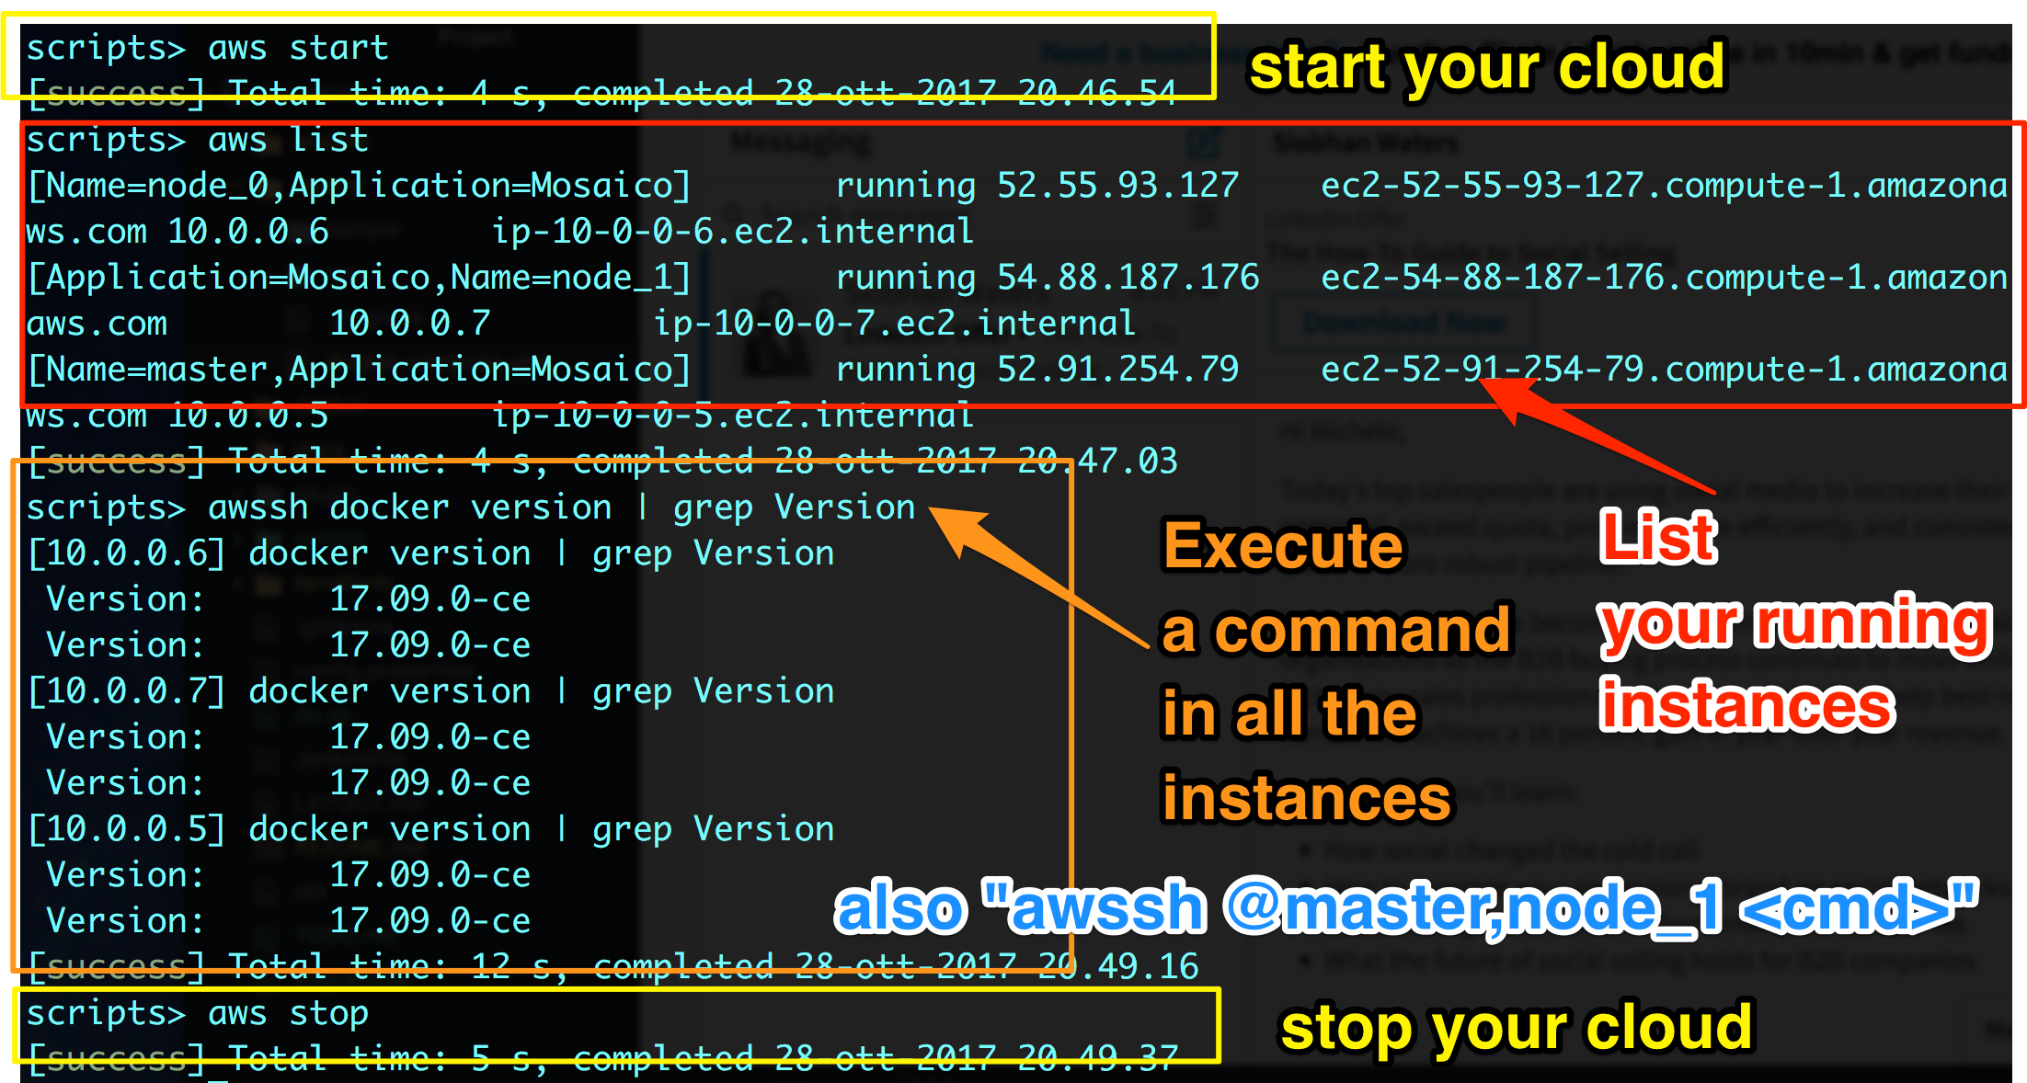
aws & awssh

Slide 29
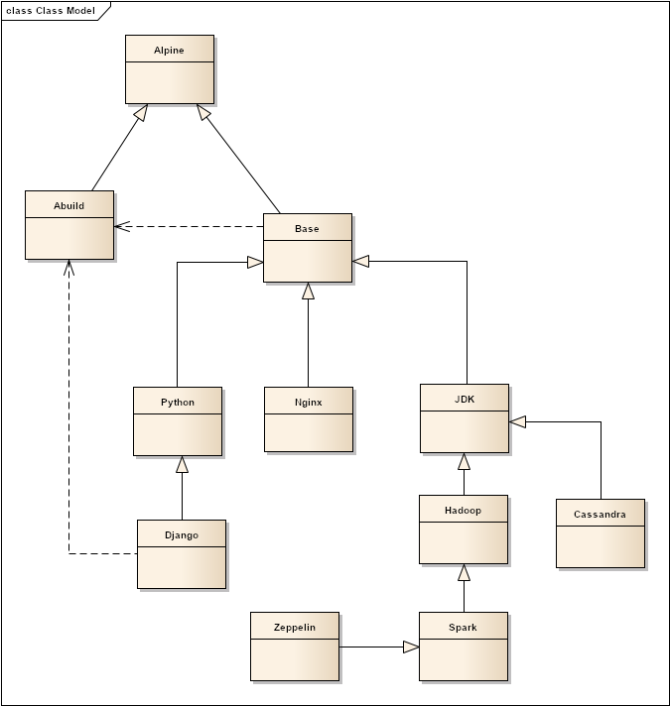
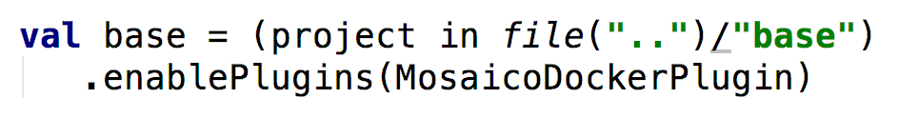
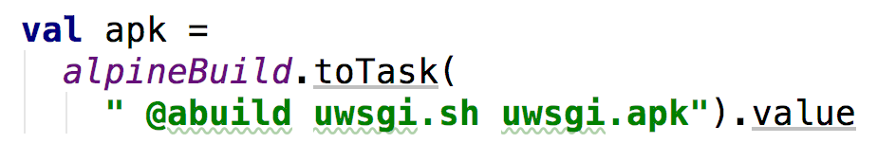
Building Images with SBT

Slide 30
What is wrong about Dockerfile?
Why do I need SBT to build images?
No preprocessing available
download
move files around
No dependencies between containers
No builds using other containers
No configuration files
No profiles

Slide 31
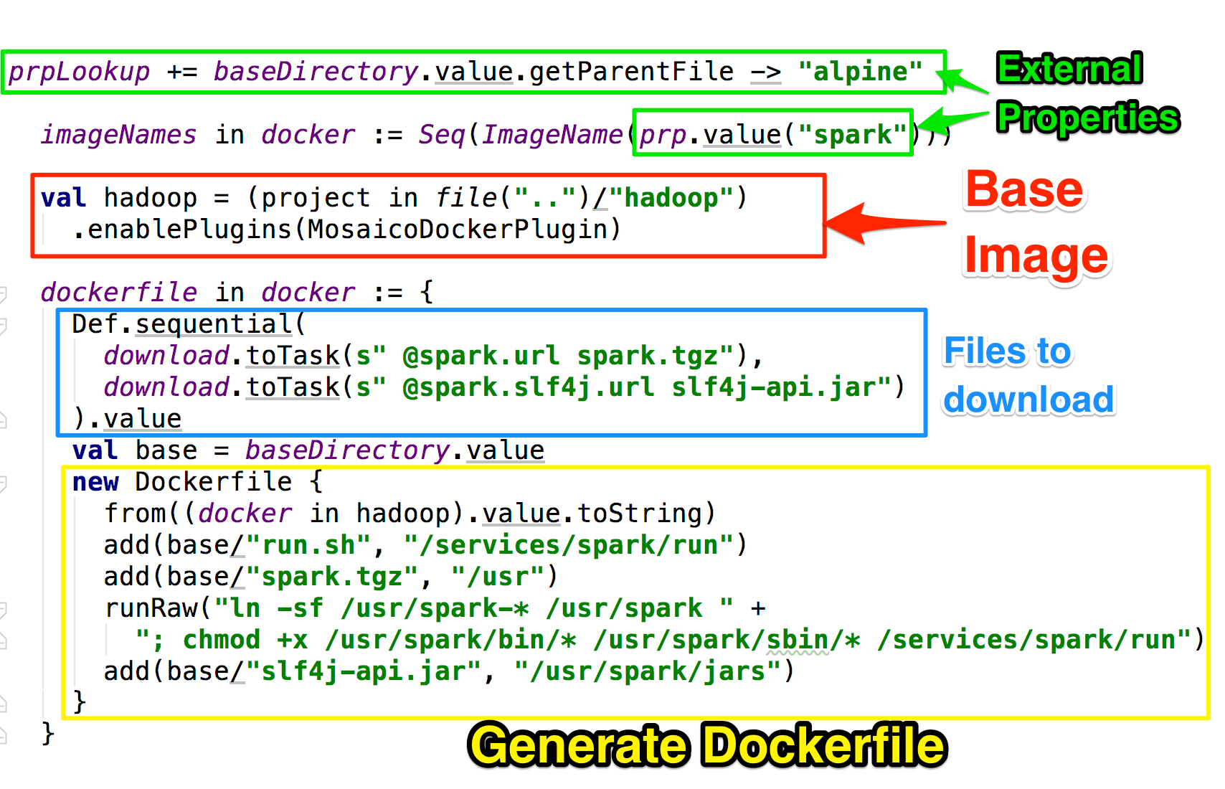
Building with SBT-DOCKER

Slide 32
MosaicoDocker SBT Plugin
Extends SBT-DOCKER
Model dependencies between containers
Can script Dockerfile generation in scala
External configuration files
Downloading of files before building the image
Ability to compile and build packages using other images
Smart "unpacking" of archives (removing unnecessary files)

Slide 33

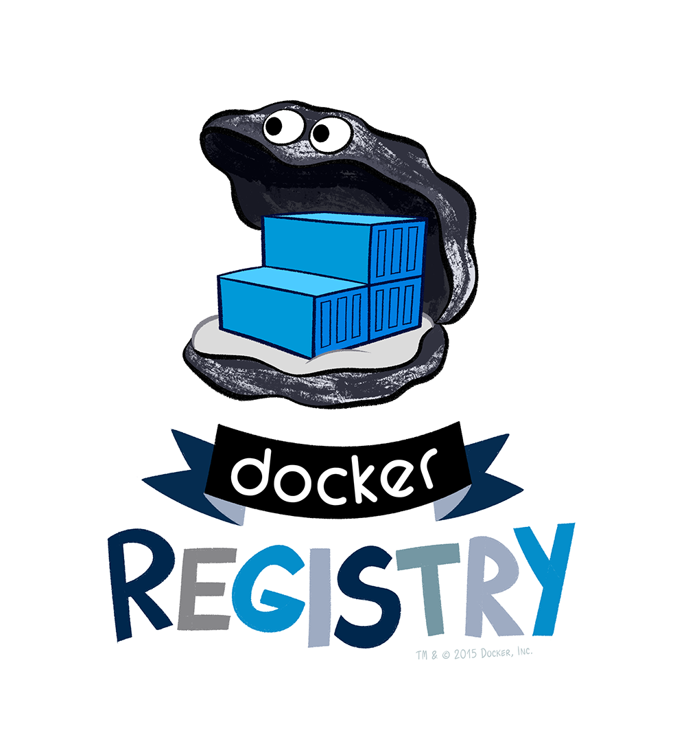

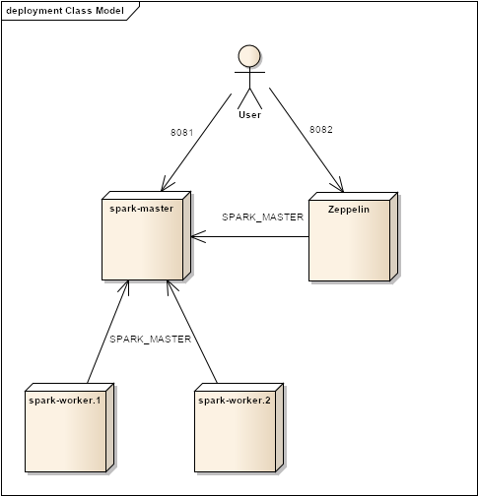
Four Steps to the Enlightment
1
2
terraform
ansible
3
4
jenkins
swarm deploy

Slide 34
Step 1: building the cloud
Ammonite
Actually: creating the VMs....

Slide 35
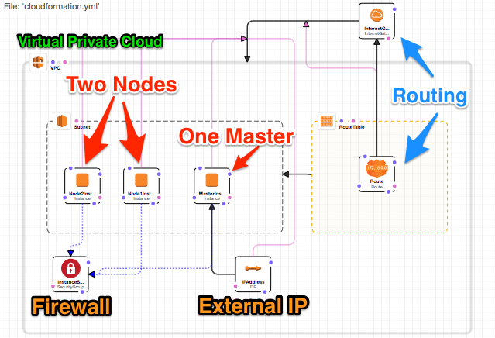
The Cloud

Slide 36
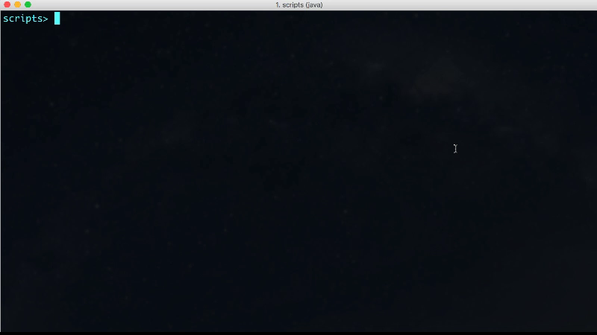
Terraform in Action

Slide 37
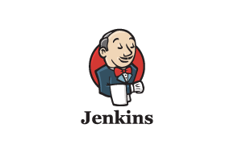
Step 2 Deploying Docker Swarm
Ammonite

Slide 38
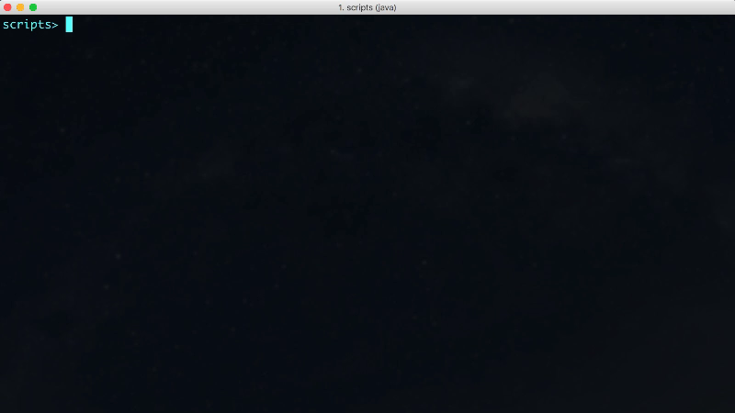
Deploy the Swarm with Ansible

Slide 39
Step 3. Building Docker Images

Slide 40
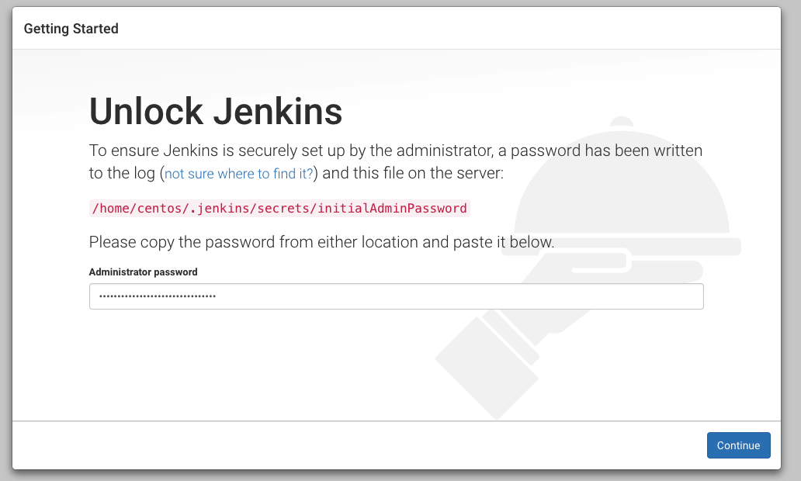
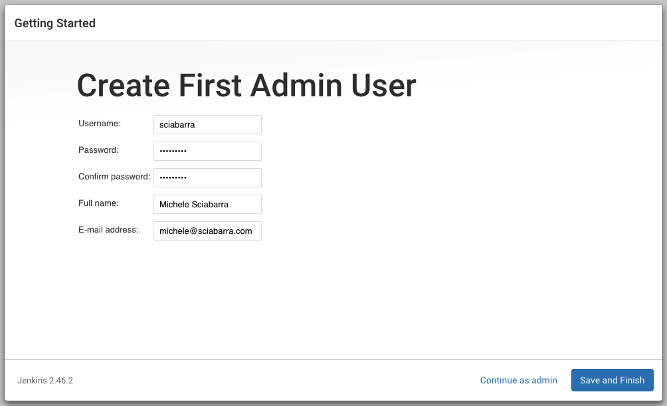
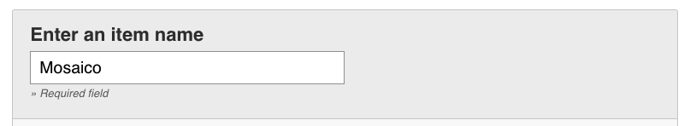
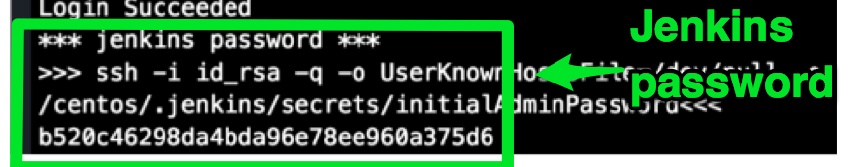
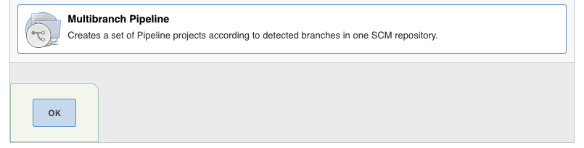
Preparing Jenkins
1
2
3

Slide 41
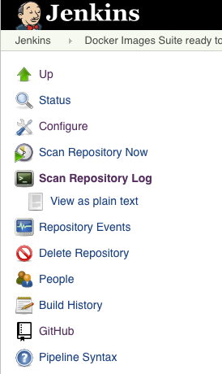

Create a Jenkins Job to build
4

Slide 42
Building Images with Jenkins

Slide 43

Final Result
with SBT and Jenkins

Slide 44
Step 4 Orchestrate
Ammonite
Docker Compose

Slide 45

Orchestrate

Slide 46

Orchestrate & Proxy

Slide 47

Thank You!

